Slide 1
Optimizing Search Engine Relevance
By
Samaneh Karimi
LinkedIn: https://www.linkedin.com/in/samane-karimi-52178459/

Slide 2
Outline
Summary
Preprocessing
Techniques and models used
Evaluation results
Conclusion and final recommendations
Python implementation and visual walk-through of the outputs

Slide 3
Summary of my approach
Analyzing raw data
Preprocessing
Model selection
Implementing the models and evaluation

Slide 4
Step1) Analyzing raw data

Slide 5
Step 1) Analyzing raw data
Goal: Knowing the characteristics of the data
Balanced or imbalanced?
=> balanced (no need for using imbalanced data handling techniques)
Analyzing feature importance:
Using ANOVA Test
Class | 1 (Relevant) | 0 (Non-relevant)
#Instance (ratio) | 34987 (44%) | 45060 (56%)
Notes:
The first step in developing a classification model is investigating the raw data and knowing its main characteristic. This information would help us make better decisions for the next steps. One of the important steps is checking if the dataset is imbalanced and needs using imbalanced data handling techniques: Imbalance is not defined formally but a ratio of 1 to 10 is usually imbalanced enough to benefit from using balancing technique.
Synthetic Minority Oversampling (SMOTE) works by creating synthetic observations based upon the existing minority observations (Chawla et al., 2002). This is illustrated in the below figure where the circles represent the majority class (e.g. non-defaulters) and the squares the minority class (e.g. defaulters). For each minority class observation, SMOTE calculates the k nearest neighbors. Let’s assume we consider the crossed square and pick the 5 nearest neighbors represented by the black squares. Depending upon the amount of oversampling needed, one or more of the k-nearest neighbors are selected to create the synthetic examples. Let’s say our oversampling percentage is set at 200%. In this case, 2 of the 5 nearest neighbors are selected at random. The next step is then to randomly create two synthetic examples along the line connecting the observation under investigation (crossed square) with the two random nearest neighbors.

Slide 6
Step 1) Analyzing the raw data (Cont.)
Top 5 features based on ANOVA test:
sig2
sig7
sig1
sig6
sig5
Notes:
Anova test checks whether there is equal variance between groups of categorical feature wrt continuous response.
Analysis of Variance is a statistical method, used to check the means of two or more groups that are significantly different from each other.
Statistics for feature selection :1) Numerical input and numerical output (regression predictive modeling problem)=> Pearson’s correlation coefficient (linear). Spearman’s rank coefficient (nonlinear)
2) Numerical input and categorical output (when we have classification predictive modeling problem)=> ANOVA correlation coefficient (linear). Kendall’s rank coefficient (nonlinear).
Kendall does assume that the categorical variable is ordinal.

Slide 7
Step 2) Preprocessing
Handling missing values
Duplicate removal
Feature scaling
Standardization
Feature selection (dimensionality reduction)

Slide 8
Step 2) Preprocessing
Handling missing values
No missing value was found in the dataset.
Duplicate removal
The redundant data may appear both in the training and testing sets and cause inaccurate learning of the model.
No duplicate was found in the dataset.
Feature scaling
The majority of machine learning algorithms perform much better when dealing with features that are on the same scale.
Standardization:
Centering the feature columns at mean 0 with standard deviation 1 so that the feature columns have the same parameters as a standard normal distribution (zero mean and unit variance).
Notes:
duplicate removal: The redundant data may appear both in the training and testing sets and cause inaccurate learning of the model
Feature rescaling is referred to as normalization and attributes are often rescaled into the range between 0 and 1. It is also useful for algorithms that weight inputs like regression and neural networks and algorithms that use distance measures like K-Nearest Neighbors.
SVMs assume that the data it works with is in a standard range, usually either 0 to 1, or -1 to 1 (roughly). So the normalization of feature vectors prior to feeding them to the SVM is very important. ... Some libraries recommend doing a 'hard' normalization, mapping the min and max values of a given dimension to 0 and 1. (min-max normalization)
Standardization is a useful technique to transform attributes with a Gaussian distribution and differing means and standard deviations to a standard Gaussian distribution with a mean of 0 and a standard deviation of 1.
This makes much more easier for the learning algorithms to learn the weights of the parameters. In addition, it keeps useful information about outliers and makes the algorithms less sensitive to them.

Slide 9
Step 2) Preprocessing (Cont.)
Feature Selection (Dimensionality Reduction)
The process of reducing the number of input variables when developing a predictive model to both reduce the computational cost of modeling and to improve the performance of the model.
Two approaches tested in this project:
Statistics for filter-based feature selection methods:
Since we have numerical input and binary annotations in our dataset => ANOVA correlation coefficient is used.
Principal Component Analysis (PCA)
finds directions of maximal variance of data

Slide 10
Step 3) Model selection
Random Forest
Support Vector Machines (SVM)
Deep Learning (MLP)

Slide 11
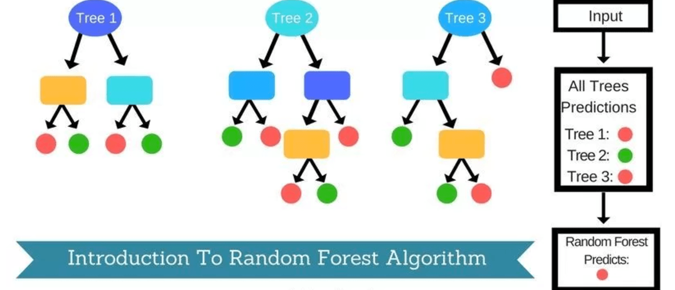
Step 3) Model selection Random Forest
The random forest approach is a ensemble (bagging) method where deep trees, fitted on bootstrap samples, are combined to produce an output with lower variance. For each test data, the output class would be the mode of the classes of the individual trees.
My reasons for choosing it:
It runs efficiently on large databases.
Since it takes the advantage of
ensemble learning, reduces variance
and thus helps us avoid overfitting.
(✔)
Image Ref: https://syncedreview.com/2017/10/24/how-random-forest-algorithm-works-in-machine-learning/
Notes:
Random Forest is an ensemble of classification algorithm widely used in much application especially with larger datasets because of its outstanding features like Variable Importance measure, OOB error detection, Proximity among the feature and handling of imbalanced datasets [1].
[1] Mohammed Zakariah, “Classification of large datasets using Random Forest Algorithm in various applications: Survey”, International Journal of Engineering and Innovative Technology (IJEIT), 2014.
bootstrapping is any test or metric that relies on random sampling with replacement.

Slide 12
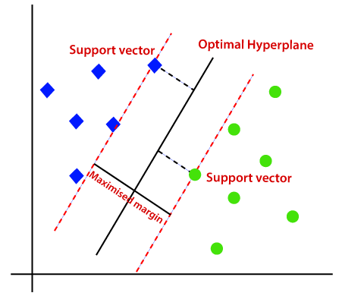
Step 3) Model selection Support Vector Machines (SVM)
SVM is a supervised machine learning algorithm that uses hyper planes to separate out different classes.
Two types:
Linear
Non-linear (Kernel-based)
My reasons for choosing it:
SVMs are suitable for numerical features (✔)
SVMs can handle non-linearly separable data (kernel trick)(✔)
Image Ref: https://www.javatpoint.com/machine-learning-support-vector-machine-algorithm
Notes:
The optimal separating hyper plane is obtained by maximizing the margin between two classes.

Slide 13
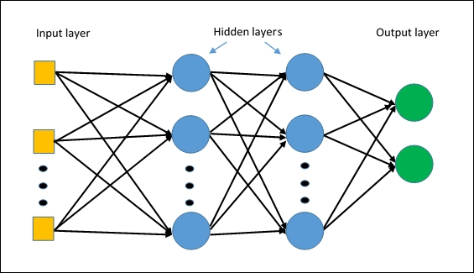
Step 3) Model selection Deep Learning (MLP)
Multilayer Perceptrons (MLPs) is a feedforward neural network that consists of multiple fully-connected layers.
My reasons for choosing it is that
MLPs are suitable for*:
Classification prediction problems (✔)
Tabular datasets (✔)
Ref*: https://machinelearningmastery.com/when-to-use-mlp-cnn-and-rnn-neural-networks/
Image Ref: https://deepai.org/machine-learning-glossary-and-terms/multilayer-perceptron
Notes:
Tabular Datasets contain data in a columnar format as in a database table. Each column (field) must have a name and each column may only contain data of one type

Slide 14
Step 4) Implementing the models and evaluation
Evaluation Protocol
Experiments

Slide 15
The Evaluation Protocol
K-fold cross validation
To avoid overfitting
To avoid wasting data as the validation set
Tuning hyper-parameters
I implemented Grid Search using a hyper-parameter optimization tool (sklearn.model_selection.GridSearchCV)
Evaluation measures
Precision, Recall, F1 and Accuracy
Notes:
k-fold CV ensures that every observation from the original dataset has the chance of appearing in training and test set In k-fold CV, the training set is split into k smaller. For each of the k “folds”:
1) A model is trained using k-1 of the folds as training data;
2) The resulting model is validated on the remaining part of the data (i.e., it is used as a test set to compute a performance measure such as accuracy).
The performance measure reported by k-fold cross-validation is then the average of the values computed in the loop.
Grid Search exhaustively generates candidates from a grid of parameter values specified for the model.

Slide 16
Experiments
The impact of feature scaling and standardization
The impact of dimension reduction techniques
Hyper-parameters tuning for the classification methods
Comparing the performance of the classification methods on the test set

Slide 17
The impact of feature scaling and standardization
Classification Method:
SVM
Feature rescaling using min-max normalization
Standardization: Centering the feature columns at mean 0 with standard deviation 1
Standardization has the highest impact
on SVM’s performance
Standardization also decreased
SVM’s training time significantly.

Slide 18
The impact of dimension reduction techniques
Experimental setup:
Classification Method:
Random Forest
5-fold Cross Validation
Evaluation Measure:
Training over 5-olds: Mean accuracy
Test set: Accuracy using the
optimal classifier
Results: The best performance on both training and testing is when no dimension reduction technique is used.

Slide 19
Hyper-parameters tuning Random Forest
Experimental setup:
Grid Search over all combinations of the Random Forest parameters as follows
'bootstrap': [True, False]
'max_depth': [10, 20, 30, 40, 50, 60, 70, 80, 90, 100, None]
'max_features': ['auto', 'sqrt']
'min_samples_leaf': [1, 2, 4]
'min_samples_split': [2, 5, 10]
'n_estimators': [200, 400, 600, 800, 1000, 1200, 1400, 1600, 1800, 2000]
5-fold Cross Validation
Tuned for both precision and recall measures
Best parameters set found on development set:
For Precision :{'bootstrap': False, 'max_depth': 10, 'max_features': 'sqrt', 'min_samples_leaf': 1, 'min_samples_split': 5, 'n_estimators': 800}
For Recall:{'bootstrap': False, 'max_depth': 20, 'max_features': 'sqrt', 'min_samples_leaf': 1, 'min_samples_split': 5, 'n_estimators': 800}
Notes:
n_estimators = number of trees in the foreset
max_features = max number of features considered for splitting a node
max_depth = max number of levels in each decision tree
min_samples_split = min number of data points placed in a node before the node is split
min_samples_leaf = min number of data points allowed in a leaf node
bootstrap = method for sampling data points (with or without replacement)

Slide 20
Random Forest performance on the test set tuned based on precision and recall
Experimental setup:
The Random Forest classifier is trained on the training set in two ways:
using optimal parameter values tuned for precision (Prec-based)
using optimal parameter values tuned for recall (Recall-based).
The training and test sets are obtained using Sklearn train_test_split module that makes random partitions for the two subsets.
sklearn.metrics.classification_report is used for reporting the model’s performance on the test set.
Notes:
The support is the number of occurrences of each class in Gold Data.
The reported averages include macro average (averaging the unweighted mean per label), weighted average (averaging the support-weighted mean per label),

Slide 21
Random Forest performance on the test set tuned based on precision and recall (Cont.)
Performance on the test set using precision-based optimal parameter
Performance on the test set using recall-based optimal parameter
Measure Class | Precision | Recall | F1-measure | Support
Class 0 (Non-Relevant) | 0.67 | 0.81 | 0.73 | 13503
Class 1 (Relevant) | 0.66 | 0.48 | 0.55 | 10511
Measure Class | Precision | Recall | F1-measure | Support
Class 0 (Non-Relevant) | 0.67 | 0.79 | 0.72 | 13503
Class 1 (Relevant) | 0.66 | 0.50 | 0.57 | 10511

Slide 22
Hyper-parameters tuning MLP
Experimental setup:
Grid Search over all combinations of the MLP parameters as follow
'hidden_layer_sizes': [(50,50,50), (50,100,50), (100,)]
'activation': ['tanh', 'relu']
'solver': ['sgd', 'adam']
'alpha': [0.0001, 0.05]
'learning_rate': ['constant','adaptive']
5-fold Cross Validation
Tuned for both precision and recall measures
Best parameters set found on development set:
For Precision: {'activation': 'relu', 'alpha': 0.05, 'hidden_layer_sizes': (100,), 'learning_rate': 'constant', 'solver': 'adam'}
For Recall: {'activation': 'relu', 'alpha': 0.0001, 'hidden_layer_sizes': (100,), 'learning_rate': 'constant', 'solver': 'adam'}
Notes:
Alpha is a parameter for regularization term, aka penalty term, that combats overfitting by constraining the size of the weights.
The ReLU is the most used activation function in deep learning tasks

Slide 23
MLP performance on the test set tuned based on precision and recall
Performance on the test set using precision-based optimal parameter
Performance on the test set using recall-based optimal parameter
Measure Class | Precision | Recall | F1-measure | Support
Class 0 (Non-Relevant) | 0.66 | 0.80 | 0.72 | 13591
Class 1 (Relevant) | 0.64 | 0.46 | 0.53 | 10423
Measure Class | Precision | Recall | F1-measure | Support
Class 0 (Non-Relevant) | 0.57 | 1.00 | 0.73 | 13591
Class 1 (Relevant) | 0.82 | 0.02 | 0.05 | 10423

Slide 24
Hyper-parameters tuning SVM
Experimental setup:
Grid Search over all combinations of the SVM parameters as follow
{'kernel': ['rbf'], 'gamma': [1e-3, 1e-4]}
{‘kernel’:[‘linear], 'C': [1, 10, 100, 1000]}
5-fold Cross Validation
Tuned for both precision and recall measures
Best parameters set found on development set:
For Precision: {'gamma': 0.001, 'kernel': 'rbf'}
For Recall: {'gamma': 0.001, 'kernel': 'rbf'}
The optimal parameter values for precision and recall are the same
Notes:
Alpha is a parameter for regularization term, aka penalty term, that combats overfitting by constraining the size of the weights.

Slide 25
SVM performance on the test set tuned based on precision and recall
Performance on the test set using precision/recall-based optimal parameter
Measure Class | Precision | Recall | F1-measure | Support
Class 0 (Non-Relevant) | 0.65 | 0.70 | 0.68 | 13562
Class 1 (Relevant) | 0.57 | 0.52 | 0.54 | 10452

Slide 26
Comparing the performance of the classification methods on test set
All models’ performances on the test set using the optimal parameters tuned for precision
Random Forest outperforms
other two models in terms of
all measures.
In terms of running time,
Random Forest trained
faster than MLP and SVM.

Slide 27
Conclusion and final recommendations
Standardization decreased the training time of the models.
The top 5 important features in the dataset according to ANOVA test are sig2, sig7, sig1, sig6 and sig5 respectively.
PCA and ANOVA feature reduction methods do not improve the classification performance on this dataset.
Due to the small number of features (13) compared to the number of instances (80047), dimension reduction increases bias and can cause under-fitting.
The performance of Random Forest and MLP on the test set is better than SVM in terms of Precision, Recall, F1 and accuracy.
The Random Forest model trained faster than MLP and SVM.

Slide 28
Conclusion and final recommendations
The per-class evaluation of all three methods show that the relevant document detection (Class 1) is a harder problem compared to identifying non-relevant documents.
The relevance optimization problem is similar to the problem of document retrieval in response to query. Therefore, the ranking of documents would be a useful information in our dataset.
The forth method used in this project is a learning to rank algorithm called SVMRank. The idea of learning the ranking of the documents for each query is an effective approach for the search engine optimization problem.

Slide 29
Python implementation and visual walk-through of the outputs
The python script attached to this report can be executed to regenerate the results reported on the slides.
In the first step for running the program, you may read the ReadMe file or enter the following command to see the instructions:
python3 RelevancePrediction.py –h
You can pass the following arguments with your command when running the code:
-d: The dimension reduction method. (available options are "PCA" and "AnovaTest")
-m: The classification model. (available options are "SVM", "MLP" and "RandomForest")
Example Command:
python3 RelevancePrediction.py –d "AnovaTest" –m "RandomForest"

Slide 30
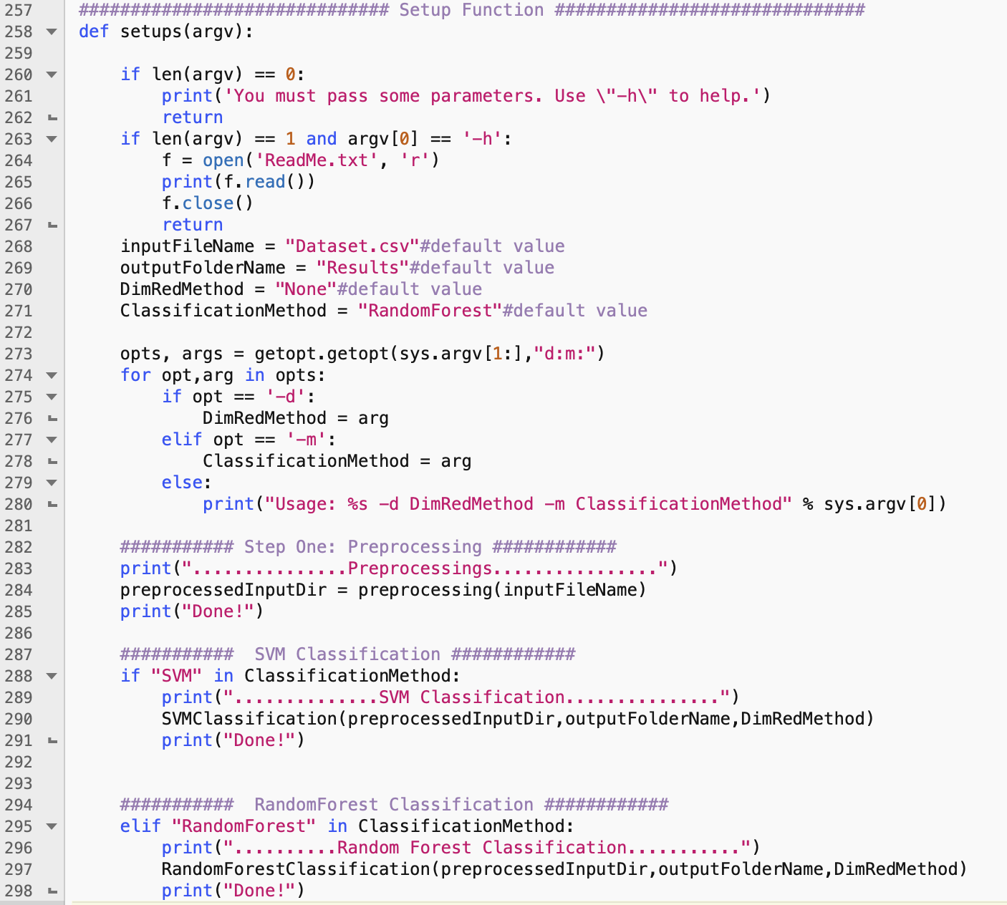
Python implementation and visual walk-through of the outputs (Cont.)
The first function called after
entering the command is setup()
It takes the arguments from
input and set the corresponding
variables.

Slide 31
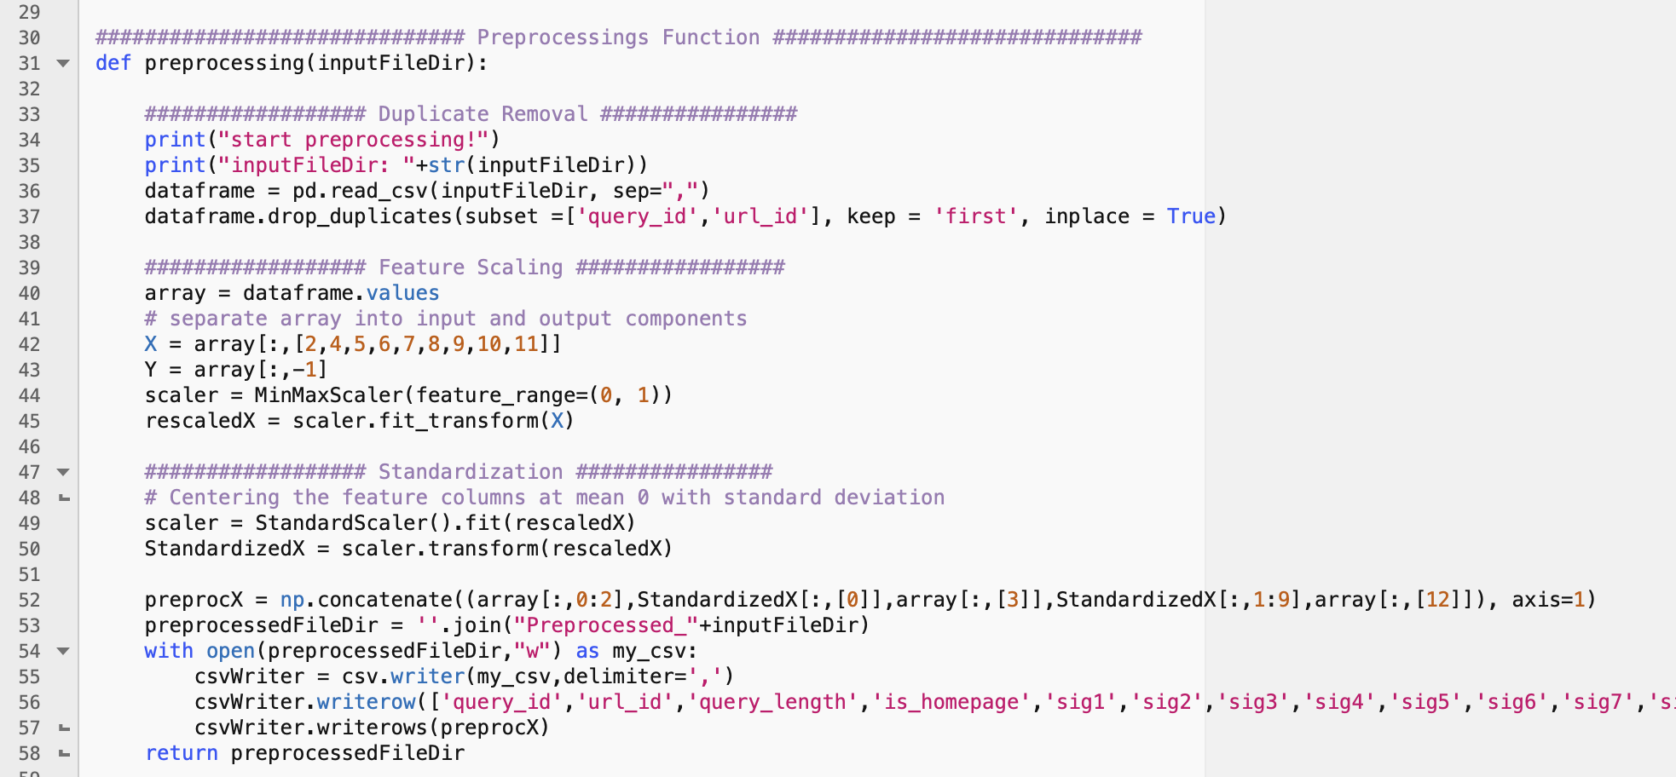
Python implementation and visual walk-through of the outputs (Cont.)
Based on the arguments, the next functions are called.
The next called function
is preprocessing.

Slide 32
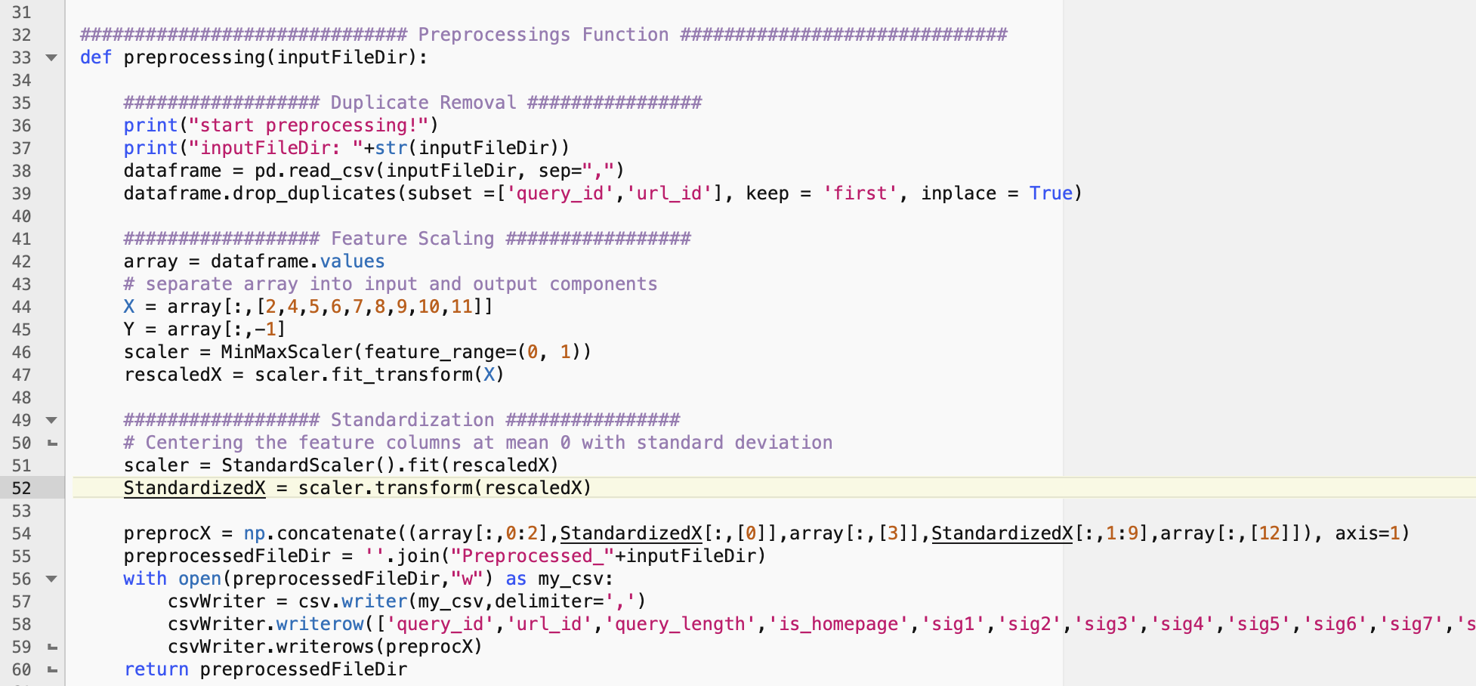
Python implementation and visual walk-through of the outputs (Cont.)
Based on the arguments, the next functions are called.
The next called function
is preprocessing.
In preprocessing function,
The duplicate instances are
removed.
Features are rescaled using
min-max normalization.
Then, features are
standardized.

Slide 33
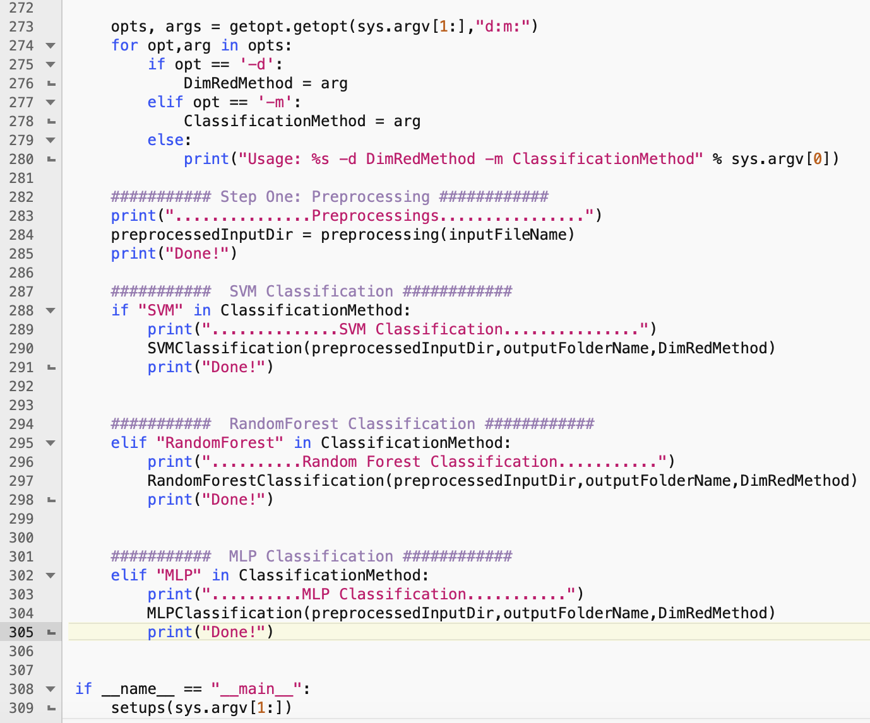
Python implementation and visual walk-through of the outputs (Cont.)
After preprocessing, according to the desired classification method set in the arguments, one of the
three classification functions are called.
SVM
Random Forest
MLP

Slide 34
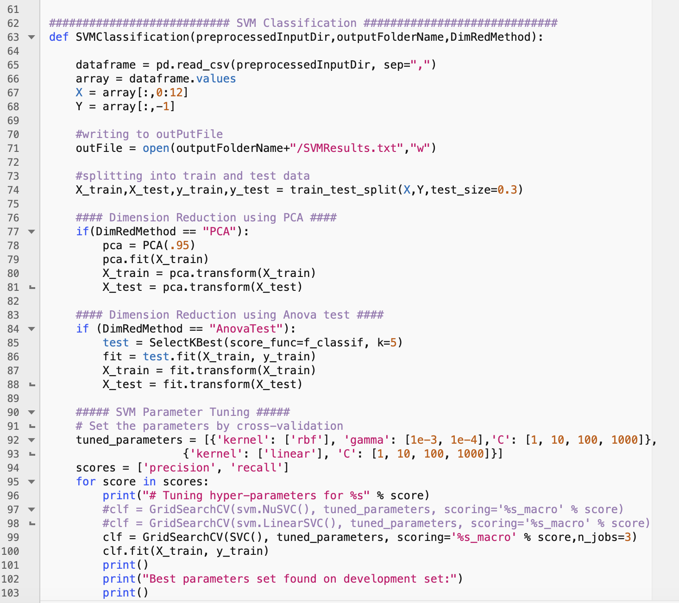
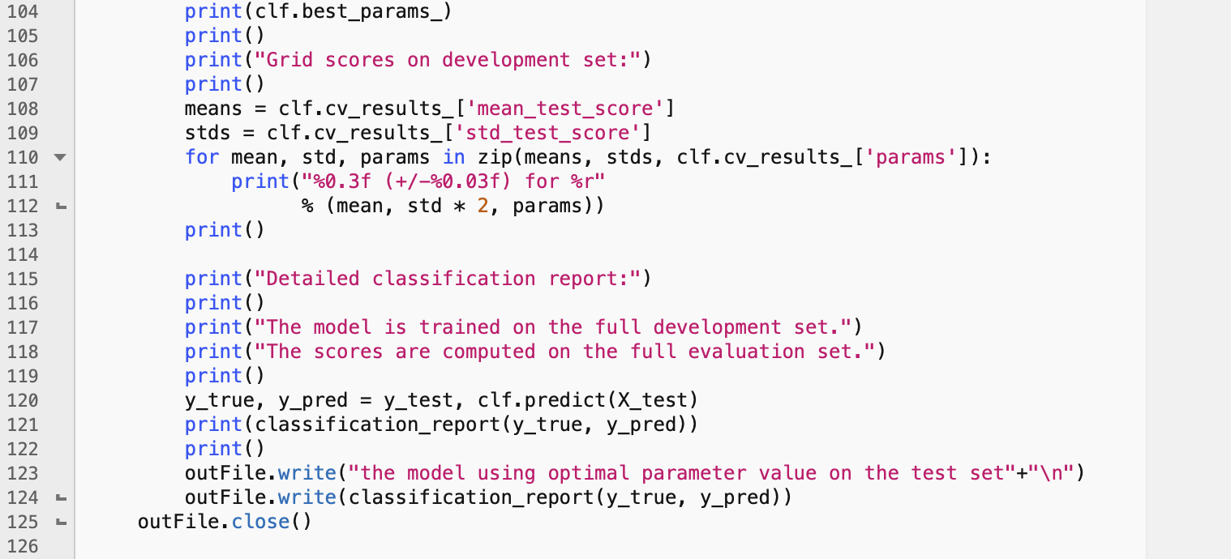
SVM Classification
First, dimension reduction
is applied (if set in command options)
Then, hyper-parameter tuning starts
by defining the values of SVM parameters
to be searched using Sklearn GridSearchCV
The GridSearch is performed using
5-fold cross validation over training set
for both Precision and Recall
After finding the optimal parameter
values, the model is trained on the
training set using the tuned parameter values
and tested on the testing set.

Slide 35
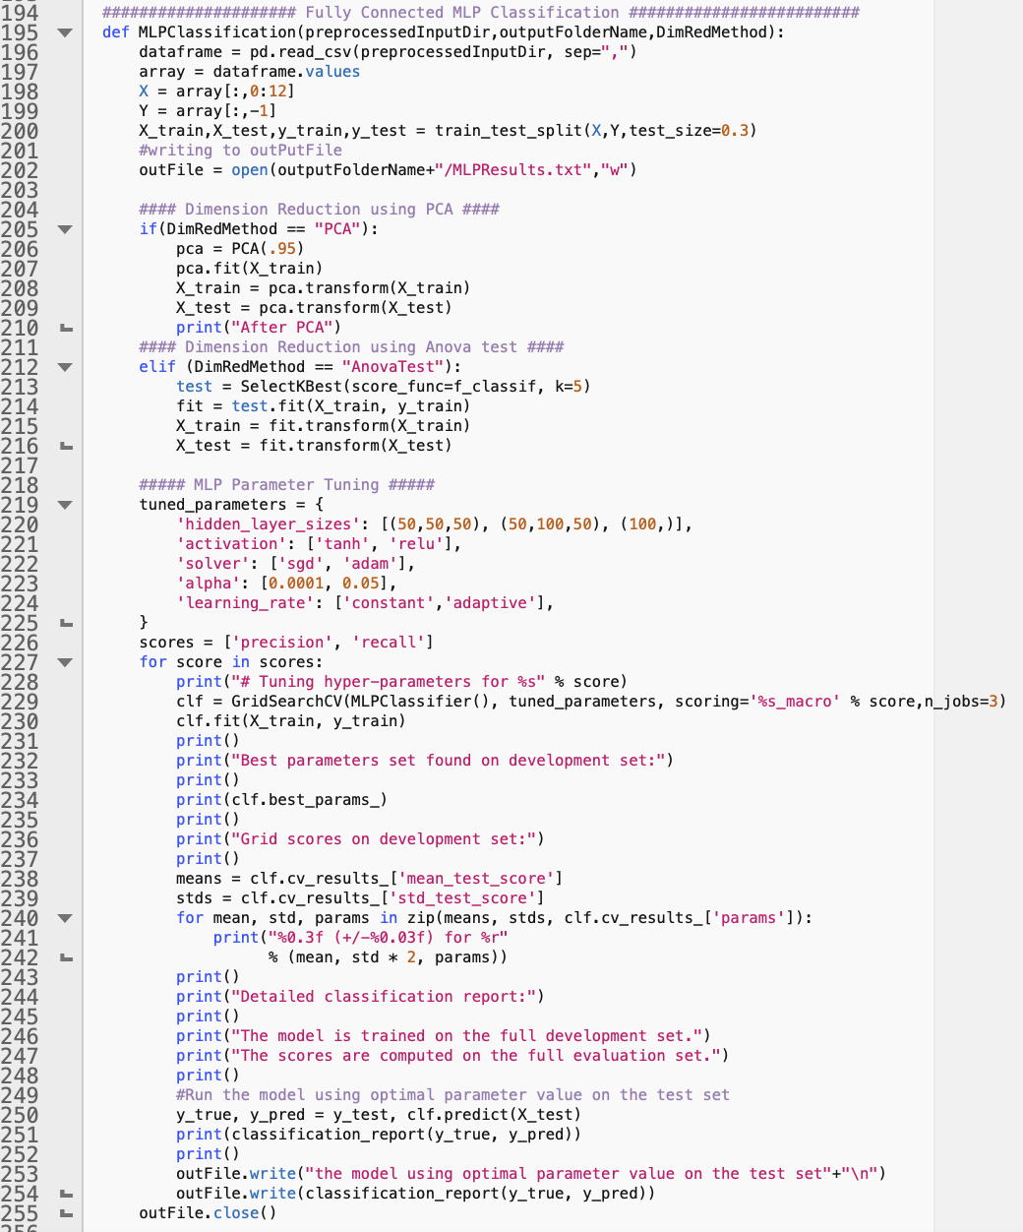
MLP Classification
The whole process is the same as SVM,
unless the MLP classification module and
also MLP parameters for tuning are different.
Three different network architectures has
been tested with different number of layers
and neurons.
Two activation functions are tested including tanh and ReLU
The result are written in a file in a direcotry called ‘Results'

Slide 36
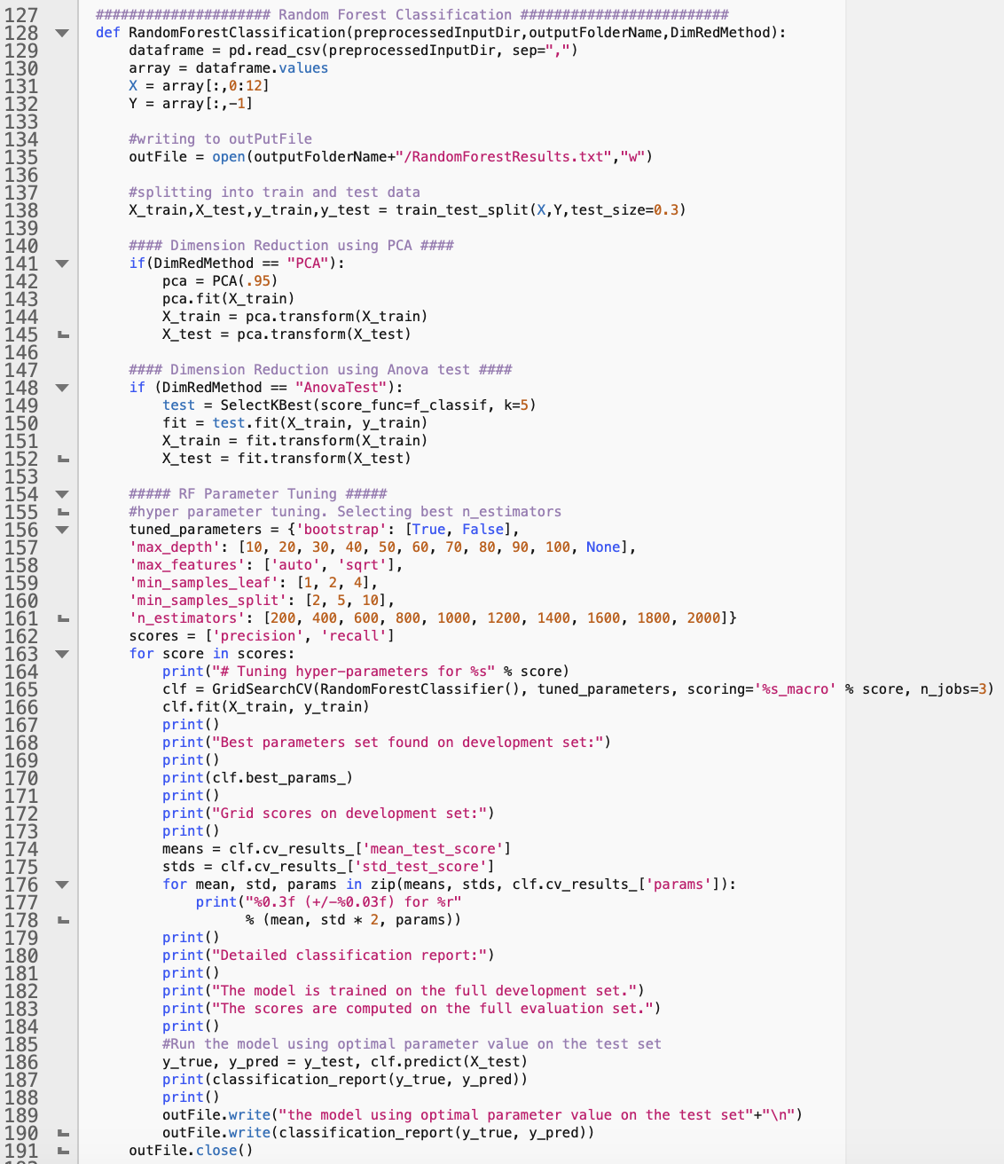
Random Forest Classification
Due to the large number of hyper-parameters in Random Forest, in order to reduce the running time, I utilized parallel processing by increasing the value of n_jobs parameter in Sklearn.

Slide 37
Thanks for your attention

